Slide 1
Measuring Effects of layoffs
on corporate reputation
using sentiment analysis
Presented By-
Rahul Kumar

Slide 2
Contents
01 Introduction
02
Literature Review
03
Steps Proposed
Sentiment analysis
Corporate reputation
Summary of works done by other authors in this field and comparison of various methodologies
Detailed steps for sentiment analysis and calculating corporate reputation
05
Result
04
Our work
Visualization and analysis of result
Data mining
Data preprocessing and model training
Data prediction and data visualization
04
Future work & Conclusion
Future scope of the work and conclusion

Slide 3

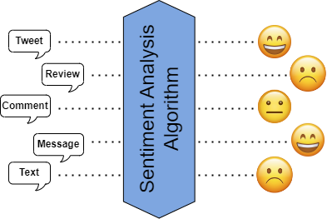
Introduction
Sentiment analysis -
Sentiment analysis, also known as opinion mining, is the process of using natural language processing and machine learning techniques to extract and identify the sentiment or emotion behind a piece of text.

Slide 4

Introduction
Corporate Reputation-
Corporate reputation refers to the perception and image that an organization has among its stakeholders, including customers, investors, employees, suppliers, and the general public.
Importance of Corporate Reputation –
It can influence consumer behavior
It can affect investor decisions
Is vital for attracting and retaining talented employees
It can affect relationships with suppliers and partners
Layoff –
A layoff or downsizing is the temporary suspension or permanent termination of employment of an employee for business reasons, such as personnel management or downsizing an organization.

Slide 5

Literature review
Authors | Dataset | Abstract
N. Nandal, et al., 2020 | Amazon Product Reviews | For the study of sentiment in product reviews, a model has been developed.
N. M. Ali, et al., 2019 | IMDB Movie Reviews | Found that deep learning models outperform classical machine learning approaches for sentiment analysis.
A. Mudinas, et al., 2019 | Financial Times, Reddit, and Twitter | Found that the relation between market trends and the sentiment is complex but it does have a dependency.
A. Skraparlis, et al., 2022 | Sentiment Viewer App | Reputational tools based on sentiment analysis have their limitations in the calculation of company reputation but can be beneficial in alarming reputational risks.
S. K. Sharma, et al., 2019 | Twitter Dataset on Mobile Companies | Identified top brands of mobile phones in India using consumer reviews on Twitter
P. Chauhan, et al., 2022 | Social Media Dataset | Analyzed past work done on election prediction using sentiment analysis and found some research gaps which can improve accuracy.
A timeline of the actions leading up to the famous event

Slide 6
Literature review
Authors | Dataset | Abstract
A. Alsaeedi, et al., 2019 | Twitter | Study of various methods of Twitter sentiment analysis gave a result that Hybrid models gave the highest accuracy of around 80%.
S. Kowshik, et al., 2020 | Text File of WhatsApp Chat | Proposed two new methods to analyze WhatsApp chats to find the emotions of a person.
F. Mehraliyev, et al., 2021 | Trip Advisor Reviews | Provided theoretical context for sentiment analysis in the hotel and tourism industries.
T. Chandurkar, and P. Tijare, 2021 | College Reviews Dataset from Public Source | Comparison of various machine learning approaches in sentiment analysis of college reviews
J. Jabbar, et al., 2019 | Amazon Product Reviews | Implemented sentiment analysis in E-Commerce application to give real-time sentiment analytics of products..
S. Kathiravan, et al., 2019 | NA | Detailed challenges and open issues in the field of sentiment analysis.
A timeline of the actions leading up to the famous event

Slide 7
Comparison of methodologies
Authors | Dataset | Methods | Accuracy
T. Chandurkar, and P. Tijare, 2019 | College Reviews Dataset from Public Source | Naïve Bayes SVM Random Forest Decision Tree Max Entropy | 80% 85% 90% 70% 95%
G. Kaur, and A. Sharma, 2022 | Amazon product reviews | SVM Decision Tree Naïve Bayes Random Forest | 82.0% 80.0% 81.2% 80.1%
M. Neethu, and R. Rajasree, 2013 | Twitter dataset on electronic products | Naïve Bayes SVM Max Entropy | 89.5% 90% 90%
G. Gautam, and D. Yadav, 2014 | Twitter dataset on customer reviews | SVM Max Entropy Naïve Bayes Semantic Analysis | 85.5% 83.8% 88.2% 89.9%
S. Bahrainian, and A. Dengel, 2013 | Twitter data On Smartphones | Unigram featured Naïve Bayes, Max Entropy, and SVM Hybrid Approach | 89.78%
A timeline of the actions leading up to the famous event

Slide 8
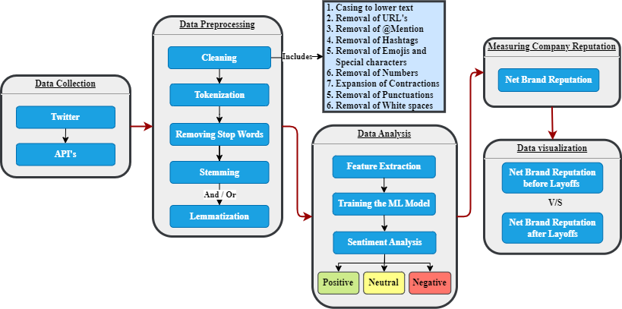
Steps Proposed

Slide 9

Data mining
Steps ->
Install and Import Snscrape
Fetch tweets in Pandas dataframe
Store the data in CSV files
DATA ->
Keyword | Quantity | Timeline
Facebook | 1 lakh | 2/1/2018 – 8/4/2023 (Approx. 5 years)
Facebook | 10 thousand | 2/1/2022 – 30/10/2023 (Before layoff)
Facebook Layoff | 10 thousand | 2/11/2022 – 8/4/2023 (After layoff)
Facebook | 10 thousand | 2/11/2022 – 8/4/2023 (After layoff)

Slide 10

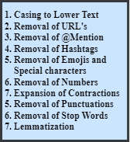
Data preprocessing
Steps ->
Data Cleaning on training data
Polarity calculation of training data
Labeling sentiments of training data
+1
-1
Negative
Positive
0
Neutral
Tweet
Steps in Data Cleaning
Polarity and Labels

Slide 11
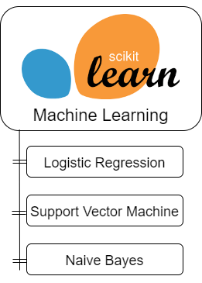
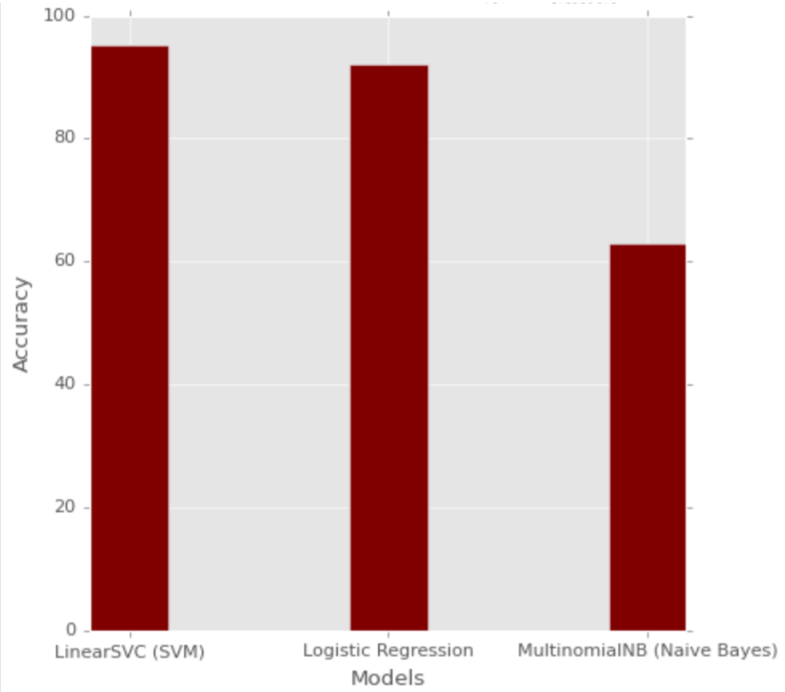
Model training
Steps ->
Data splitting
Vectorization
Training the models
Testing the models
Accuracy Comparison

Slide 12

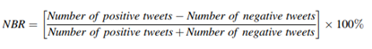
Data prediction & Corporate reputation
Steps ->
Data cleaning
Vectorization
Prediction
Calculating Corporate Reputation
Net Brand Reputation Formula

Slide 13
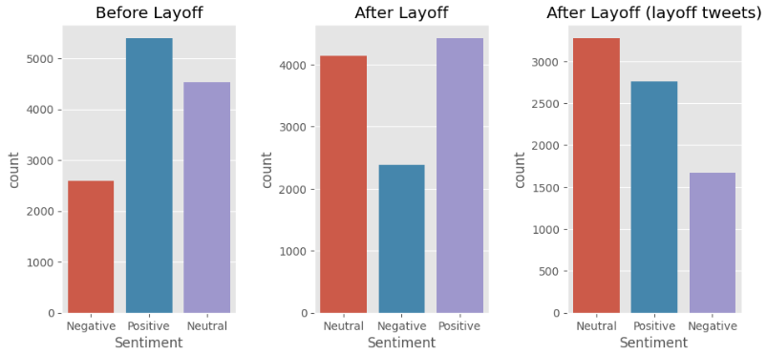
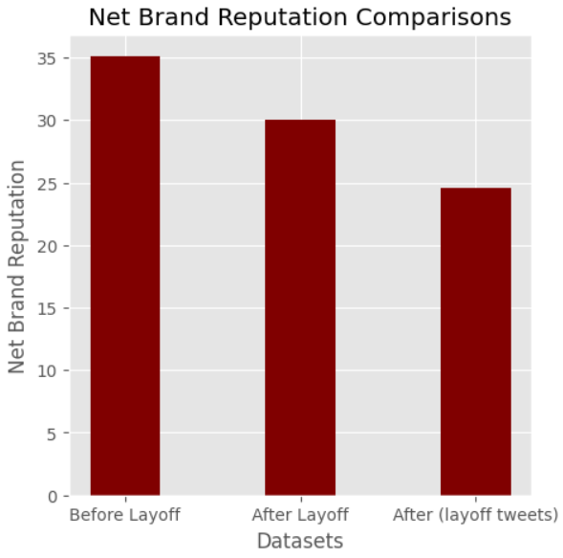
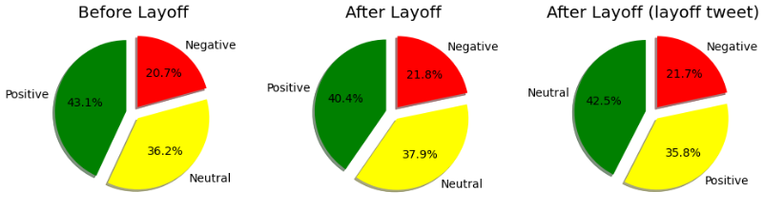
Result
Count plots of tweets
Net Brand Reputation Comparison
Pie chart of sentiments

Slide 14

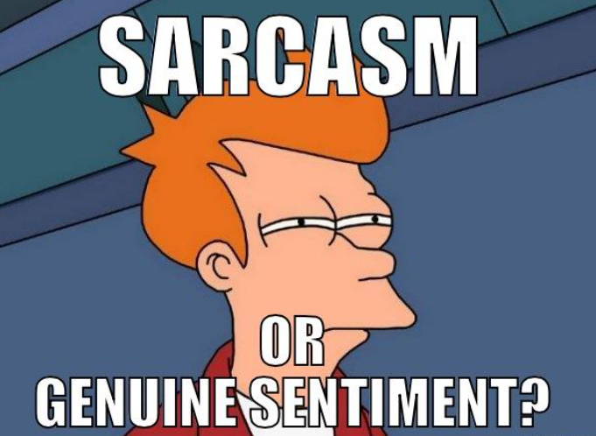
Future work
Sentiment from images and gifs
Sarcasm and irony detection
More effective ways to clean the informal and grammatical errors

Slide 15


Conclusion
Sentiment analysis on social media platforms like Twitter is done to follow how companies and products are perceived in consumer evaluations and assist a business in understanding its reputation in the market.
In this work, we found Support Vector Machine performs the best among all machine learning models for sentiment analysis of social media data.
We also found that layoff has given a negative impact on corporate reputation of the company as expected. Though the margin was not to large.

Slide 16
References
R. Kumar, G. Kaur, A. Vasisht, Harshul, Sujal, “Survey on measuring effects of layoffs on corporate reputation using sentiment analysis”, [accepted and presented in 7th INTERNATIONAL JOINT CONFERENCE ON COMPUTING SCIENCES (ICCS- 2023)]
N. Nandal, R. Tanwar, and J. Pruti, “Machine learning-based aspect level sentiment analysis for Amazon products”. Spat. Inf. Res. 28, (2020), pp. 601–607.
N. M. Ali, M. M. A. Hamid, and A. Youssif, “Sentiment analysis for movie reviews dataset using deep learning models”. International Journal of Data Mining & Knowledge Management Process (2019). Vol.9, No.2/3.
A. Mudinas, D. Zhang, and M. Levene, “Market Trend Prediction using Sentiment Analysis: Lessons Learned and Paths Forward”. arXiv:1903.05440 [cs.CL], (2019).
I. Syllaidopoulus, A. Skraparlis, and K. Ntalianis, “Evaluating Corporate Online Reputation through Sentiment Analysis of News Articles: Threats, Maliciousness and Real Opinions”. International Journal of Cultural Heritage (2022), Vol 7, p.p. 8 -22.
S. K. Sharma, M. Daga, and B. Gemini, “Twitter sentiment analysis for brand reputation of smart phone companies in India,” in Proceedings of ICETIT (2019), pp. 841–852.
P. Chauhan, N. Sharma, and G. Sikka, “The emergence of social media data and sentiment analysis in election prediction”. J Ambient Intell Human Comput 12, (2022), pp. 2601–2627.

